Slide 1
the still, small voice
1 KINGS 19

Slide 2
elijah fallen
1 KINGS 18 – TRIUMPH
1 KINGS 19 – DISPAIR

Slide 3
what are you doing here?
1 KINGS 19:10 & 14
I did my part.
You failed.

Slide 4
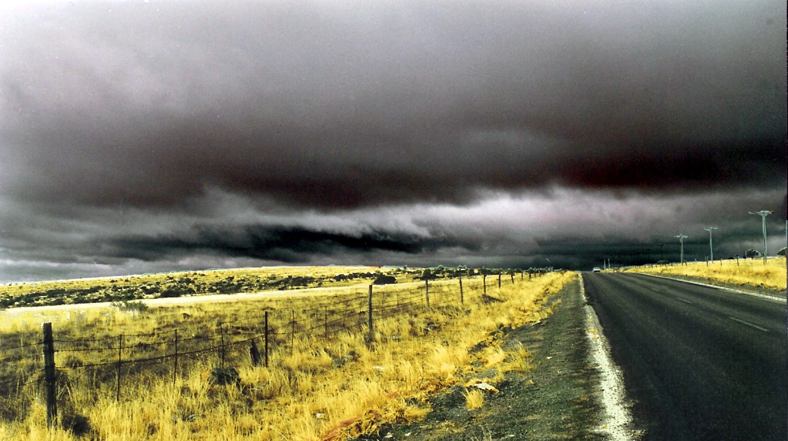
care beyond words
1 KINGS 19
Rest, touch, and food, v. 5-6
Strength, purpose, and hope, v. 7-9
Expected and unexpected presence, v. 11-12

Slide 5
words beyond power
1 KINGS 19:12
“a still small voice” (KJV)
“the sound of a low whisper” (ESV)
“a sound of sheer silence” (NRSV)

Slide 7
work beyond expectation
1 KINGS 19:13-17
God had prepared kings.
God had prepared a prophet.
God had prepared his people.

Slide 8
the still, small voice
God cares even when you doubt it.
God speaks even when you aren’t listening.
God works even when you stop believing.

