Slide 2
Christ the Messenger
Hebrews 1 & 2

Slide 3
Does God Speak?
Questions Behind the Text
Did God speak in the past?
Does God still speak?
To which voice should we listen?
Answer In the Text: Christ is the True & Better Messenger of God.

Slide 4
Long Ago …
Hebrews 1:1 Long ago, at many times and in many ways, God spoke to our fathers by the prophets, …
Yes, God has spoken.
Yes, God has spoken in many ways.
Yes, God has spoken to the prophets.
Yes, you should listen when God speaks.

Slide 5
Now the Son
Hebrews 1:2-4 … but in these last days he has spoken to us by his Son, whom he appointed the heir of all things, through whom also he created the world. He is the radiance of the glory of God and the exact imprint of his nature, and he upholds the universe by the word of his power. After making purification for sins, he sat down at the right hand of the Majesty on high, having become as much superior to angels as the name he has inherited is more excellent than theirs.

Slide 6
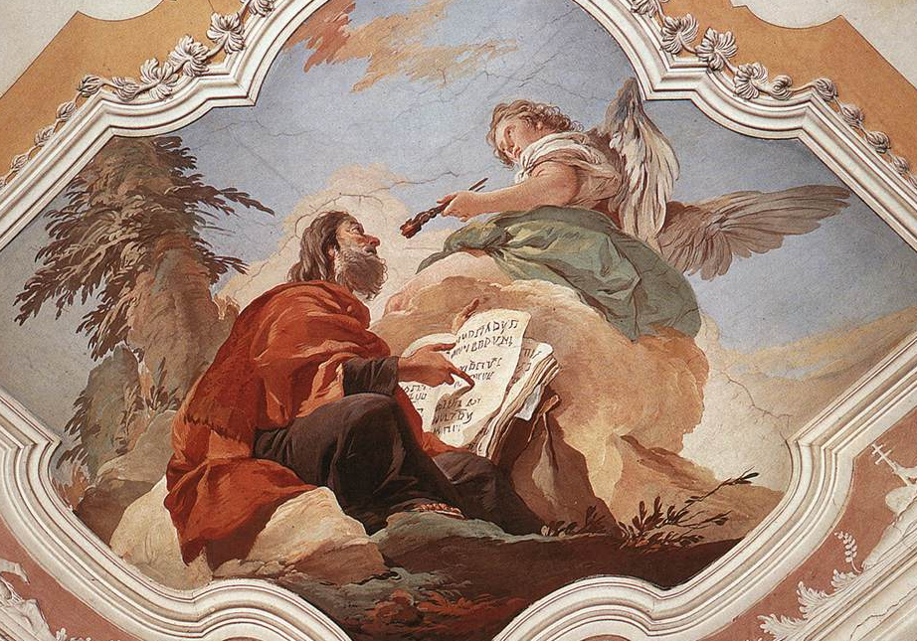
Why Angels?

Slide 7
True & Better Messenger
Because He is the Son, Hebrews 1:5
Because He is worshipped, Hebrews 1:6
Because He is enthroned, Hebrews 1:7-9
Because He is Creator, Hebrews 1:10-12
Because He is at the right hand, Hebrews 1:13-14

Slide 8
True & Better Messenger
Because He is Lord, Hebrews 2:5-8
God is creating at this moment his new world.
A man has been declared Lord of this world.
Neither man nor angel has received this honor before.

Slide 9
True & Better Messenger
Because He suffered, Hebrews 2:9
He has been made low so that he may rise that much higher.
Suffering has become his crown.
Death has become his victory.

Slide 10
Pay Attention
Hebrews 2:1-4 Therefore we must pay much closer attention to what we have heard, lest we drift away from it. For since the message declared by angels proved to be reliable, and every transgression or disobedience received a just retribution, how shall we escape if we neglect such a great salvation? It was declared at first by the Lord, and it was attested to us by those who heard, while God also bore witness by signs and wonders and various miracles and by gifts of the Holy Spirit distributed according to his will.

