Slide 1
Progress

Slide 2
Review
Tradition vs. Traditionalism
Tradition: democracy of the dead
Traditionalism: tyranny of the past

Slide 3
Progress vs. Progressivism
Progress vs. Progressivism
Progress: looking to the future
Progressivism: contempt for the past
Jeremiah 6:16 Thus says the LORD: “Stand by the roads, and look, and ask for the ancient paths, where the good way is; and walk in it, and find rest for your souls. But they said, ‘We will not walk in it.’”

Slide 4
A View of the Past
Traditionalism seems to think that we have never done wrong, or that nothing could ever be better.
Progressivism seems to think that we have never done right, or that nothing could ever be worse.

Slide 5
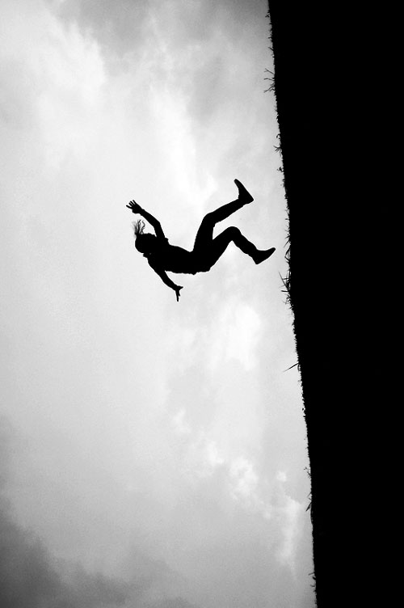
A World Without Boundaries
Traditionalism wants to protect the past from the future by putting up boundaries.
Progressivism wants to protect the future from the past by pulling down boundaries.
Traditionalism wants to be safe, even at the cost of freedom.
Progressivism wants to be free, even at the cost of safety.

Slide 6
Issues That Arise
SOCIAL LIFE
CHURCH LIFE
Sexual Identity
Gender Roles in the Family
Subjective Ethics
The Purpose of Society
Marriage & Sexuality
Gender Roles in the Church
Subjective Authority
The Purpose of the Church

Slide 7
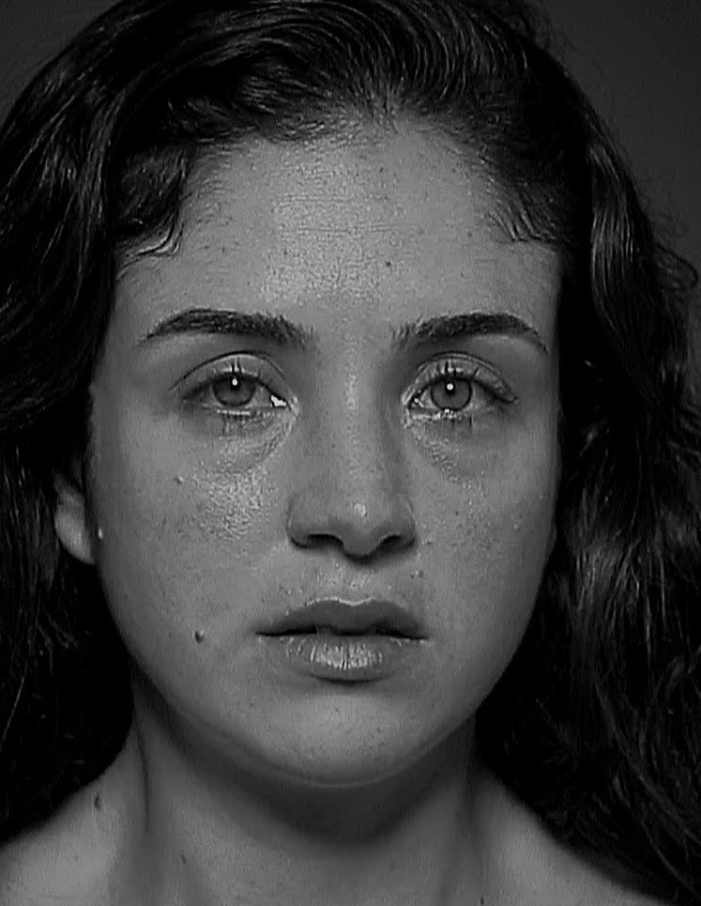
A World Without Boundaries
Judges 17:6
Judges 18 – Violence & Idolatry
Judges 19 – Rape & Murder
Judges 20 – War
Judges 21 – Human Trafficking
Judges 21:25
Aiming at “freedom,” we find only terror and oppression.

Slide 8
What Is True Progress?
Psalm 119:105-112
v. 105, Progress requires a guide.
v. 106, Progress is devotion.
v. 107, Progress requires a source.
v. 108, Progress is humility (worship and learning).
v. 109, Progress is remembrance.
v. 110, Progress requires boundaries.
v. 111, Progress is joyful.
v. 113, Progress endures.

Slide 9
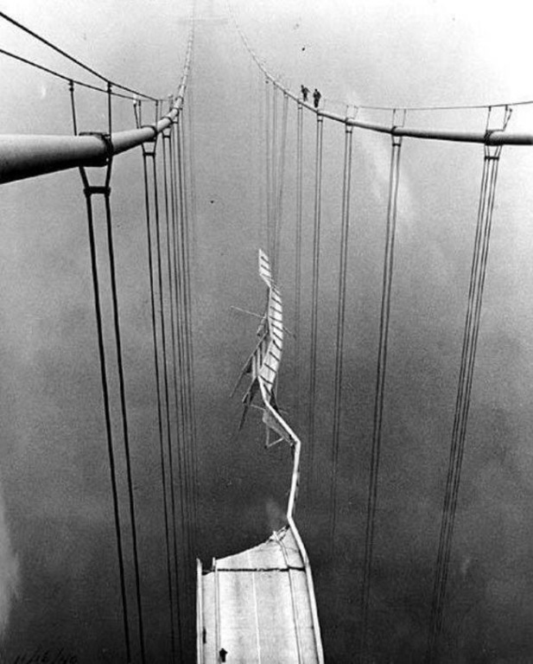
What Is Progress?
“We all want progress, but if you’re on the wrong road, progress means doing an about-turn and walking back to the right road; in that case, the man who turns back soonest is the most progressive.” – C.S. Lewis

Slide 10
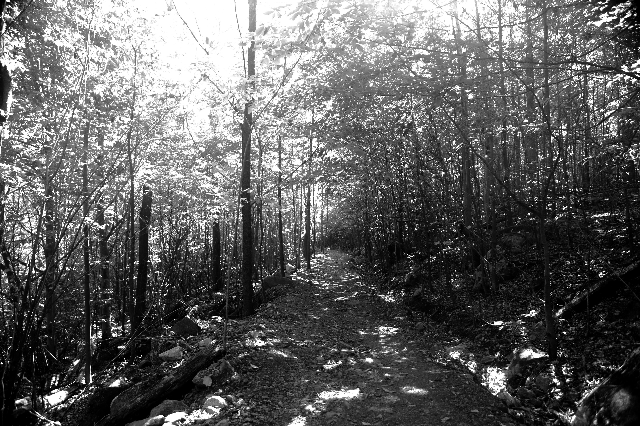
Jeremiah 6:16
Thus says the LORD: “Stand by the roads, and look, and ask for the ancient paths, where the good way is; and walk in it, and find rest for your souls. …”

